Slide 1
Predicting export volume of Crude oil between Canada and United States of America using time series analysis
Urmidola Raye
Final Capstone Project Presentation

Slide 2
Outline
Project objectives
Dataset
Data visualization
Methods of Time series Forecasting
Forecasting using ARIMA method
Forecast Evaluation
Summary and Future work

Slide 3
Project objectives
The oil market is suffering a severe downturn due to imbalance between production and demand of crude oil supply.
The production has increased thousand times than the demand and as a result the oil producing countries are forced to cut down prices which resulted in layoffs of thousands of workers from their job.
The United States of America also suffered heavily due to such imbalance between supply and demand of crude oil.
There is practically no profitable wells in the US left to drill oil and as such they depend on import of crude oil from other countries.
Countries like Algeria and Nigeria which used to export crude oil only to the US started competing for Asian markets as well.

Slide 4
Project Objectives
In such scenario, this study will take an attempt to forecast the export volume of crude oil between the United States and Canada.
The study will try to execute various forecasting methods especially ARIMA to predict the export volume of crude oil in 2015 based on historical dataset from 2000 till 2014.
The forecasted values will then be compared with the actual 2015 export volume data and the accuracy of the model will be justified.
If the export volume shows an increasing trend even during the recession time of oil market, then it will put pressure on the OPEC, a cartel of oil producers to reduce oil production to help firm up prices as well as mop up global market shares which in turn might improve the economic condition of the oil market.

Slide 5
Dataset
The data was downloaded from http://open.canada.ca/data/
The data on origin country, destination country, number of megabarrels exported in each month of each year has been considered.
The dataset consists of crude oil export volume between Canada and USA from 2000 till 2014.
The dataset represents a univariate time series as it is a sequence of measurement of the same variable megabarrels/day (Mb/d) collected over a time of 15 years.

Slide 6
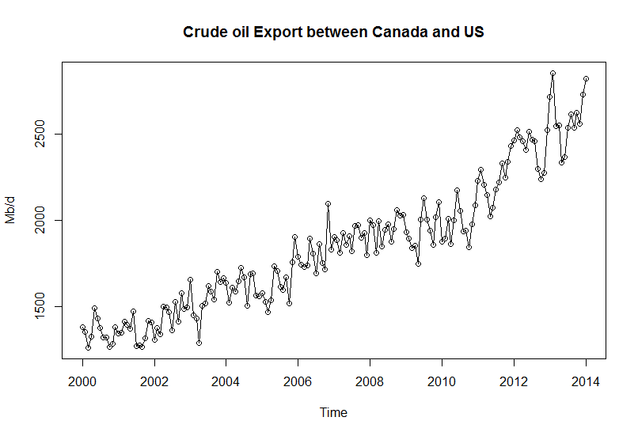
Data Vizualization
A collection of data recorded over a period of time (yearly).
The data clearly shows an increasing upward trend.
The time series is not stationary as the mean and variance are not constant but a function of time.
The time series was next checked for stationarity using auto correlation function (ACF) and partial auto correlation function(PACF)

Slide 7
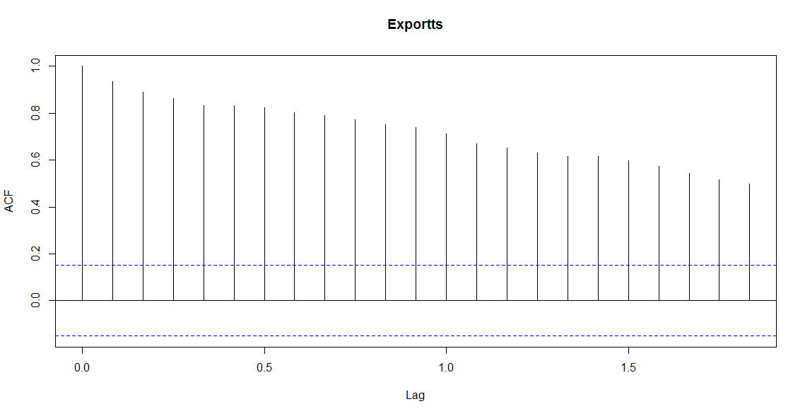
Auto Correlation Function
The ACF values are well above the confidence bands (blue dashed lines) and decays very slowly with increasing lag.
This imply non-stationarity of the data and significant correlations within the data at each lag

Slide 8
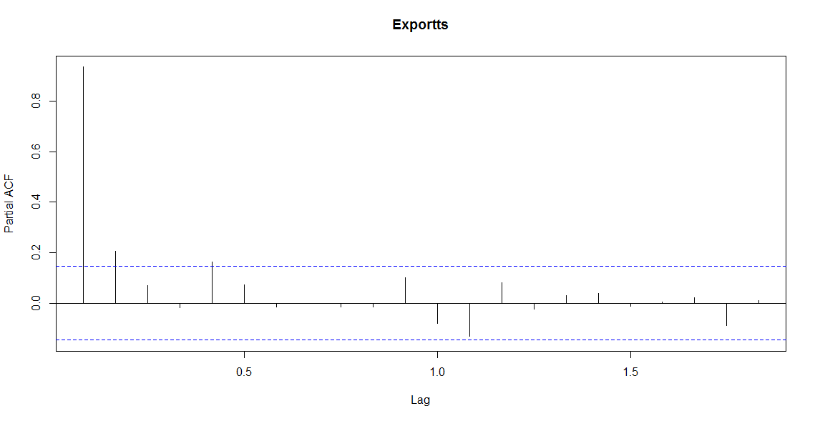
Partial Auto Correlation Function
In the PACF plot, we observe one very strong lag and the PACF cuts off after the 2nd lag
After checking for stationarity, the time series was decomposed into its components

Slide 9
Dickey-Fuller test of stationarity
In this test, null hypothesis of whether a unit root is present in an autoregressive model is present or not is tested. If unit root is present, then the process is non-stationary.
Augmented Dickey-Fuller Test data:
Dickey-Fuller = -4.5715, Lag order = 0, p-value= 0.01
alternative hypothesis: stationary
Augmented Dickey-Fuller Test data:
Dickey-Fuller = -4.5715, Lag order = 0, p-value= 0.99
alternative hypothesis: explosive

Slide 10
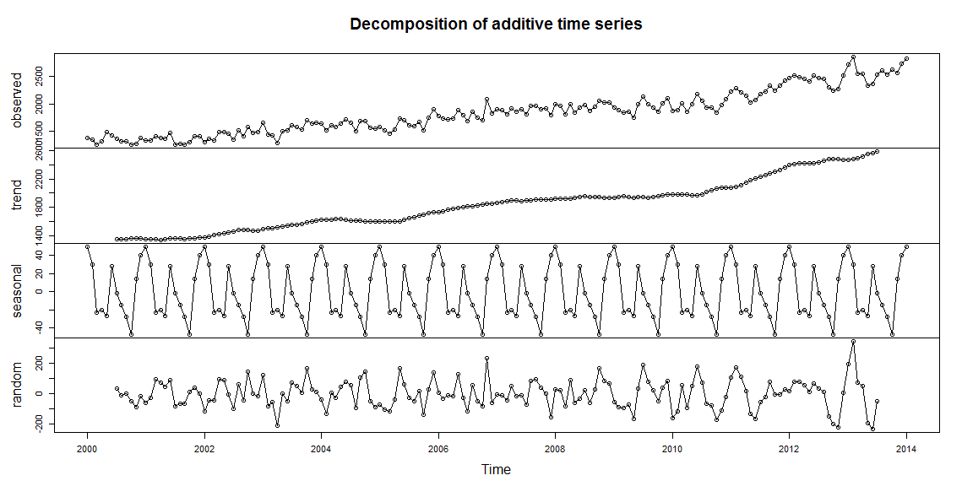
The time series has a seasonal component.
The crude oil export volume is highest during January, gradually decreases February onwards and again increases in June followed by gradual decrease and hits lowest in October and again rises in November and December each year.

Slide 11
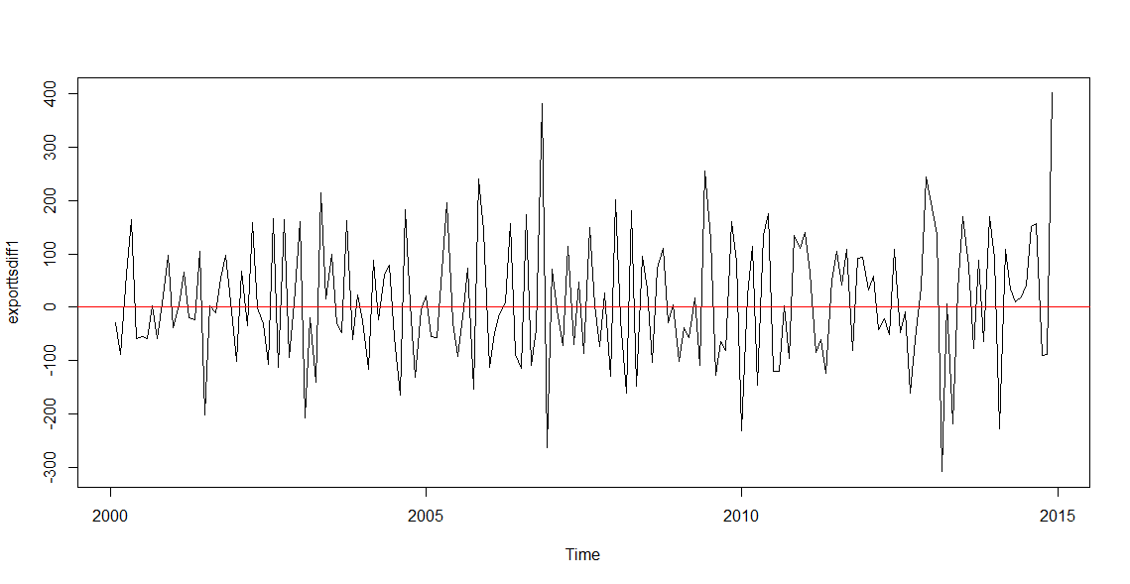
Differencing time series to achieve stationarity
Differencing help stabilize the mean of a time series by removing changes in the level of a time series, and so eliminating trend and seasonality
The mean is still non zero (10.96) and the variance is variable but the upward increasing trend of the time series is removed

Slide 12
Methods of Time Series Forecasting
Notes:
35

Slide 13
Moving Average Method
Series of arithmetic means
Used only for smoothing
Provides overall impression of data over time
Notes:
36

Slide 14
Methods of Time Series Forecasting
Notes:
104

Slide 15
Autoregressive Modeling
Used for forecasting trend
Like regression model
Independent variables are lagged response variables Y_{i-1}, Y_{i-2}, Y_{i-3} etc.
Assumes data are correlated with past data values
1st Order: Correlated with prior period
Estimate with ordinary least squares
Notes:
105

Slide 16
Forecasting using the ARIMA method
Autoregressive Integrated Moving Average (ARIMA) models include an explicit statistical model for the irregular component of a time series, that allows for non-zero autocorrelations in the irregular component.
ARIMA models are defined for stationary time series.
If a time series is differenced d times to obtain a stationary series, then an ARIMA (p,d,q) model is obtained, where d is the order of differencing used.

Slide 17
Choosing the best model
exparima1 <- arima(exporttsdiff2, order = c(5, 2, 1), seasonal = c(1,0,0))
exparima2 <- arima(exporttsdiff2, order = c(4, 2, 1), seasonal = c(1,0,0))
exparima3 <- arima(exporttsdiff2, order = c(3, 2, 1), seasonal = c(1,0,0))
exparima5 <- arima(exporttsdiff2, order = c(5, 0, 1), seasonal = c(1,0,0))
exparima6 <- arima(exporttsdiff2, order = c(4, 1, 2),seasonal = c(1,0,0))
exparima7 <- arima(exporttsdiff2, order = c(3, 1, 3), seasonal = c(1,0,0))

Slide 18
Forecasting choosing the auto arima function
Series: exporttsdiff2
ARIMA(5,0,1)(1,0,0)[12] with zero mean
Coefficients:
ar1 ar2 ar3 ar4 ar5
-0.4036 -0.3626 -0.2268 -0.3696 -0.1569
s.e. 0.0777 0.0776 0.0807 0.0785 0.0783
ma1 sar1
-0.9758 0.1777
s.e. 0.0207 0.0797
sigma^2 estimated as 10916: log likelihood = -1079.36
AIC = 2174.72 AICc = 2175.57 BIC = 2200.17

Slide 19
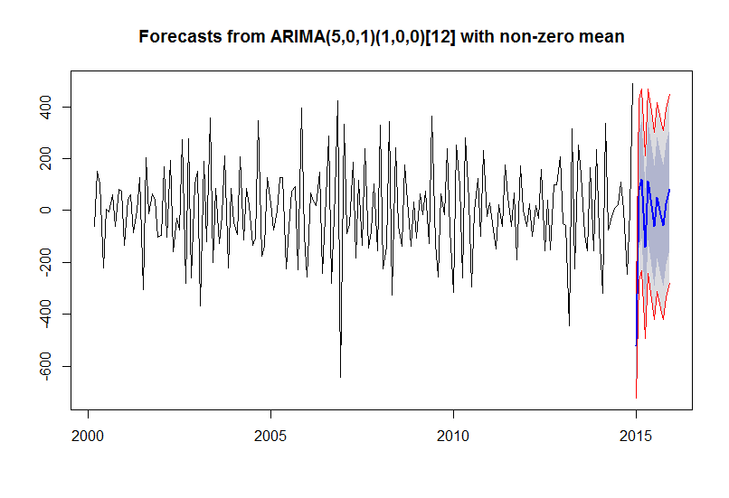
Forecasts from ARIMA
The forecasts for 2015 are plotted as a blue line, the 80% prediction interval (dark grey shaded area) and 95% prediction interval is shown by light grey shaded area are bounded by red lines

Slide 20
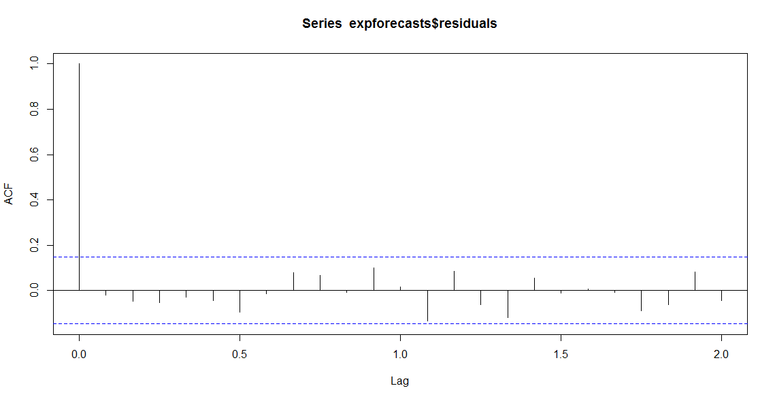
Evaluating Forecasts
Forecast errors = the observed - predicted values for each time point.
In sample forecast errors are stored in the named element “residuals” of the list variable returned by forecast ARIMA.
In a good fit predictive model, there should be no correlations between forecast errors for successive predictions. This is checked using a correlogram.

Slide 21
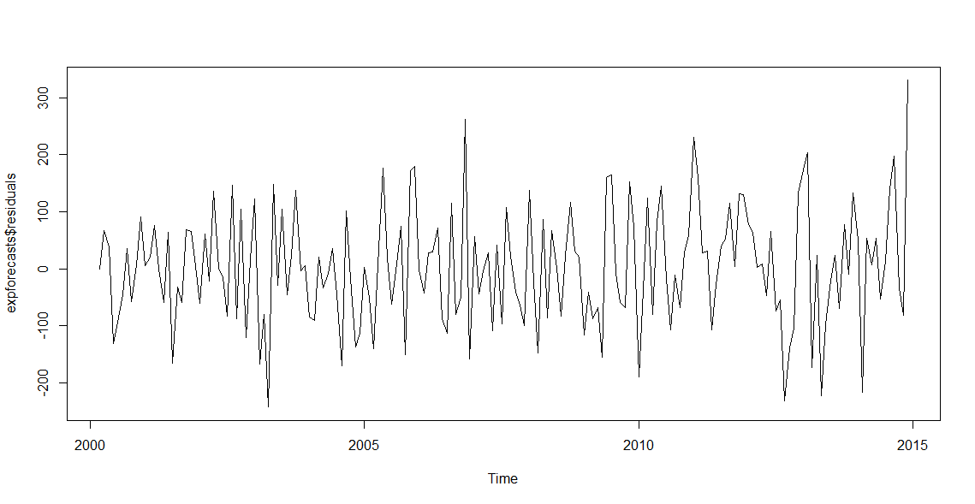
Evaluating Forecasts
To check whether the predictive model can be improved upon or not , it is a good idea to check whether the forecast errors are normally distributed with mean zero and constant variance.

Slide 22
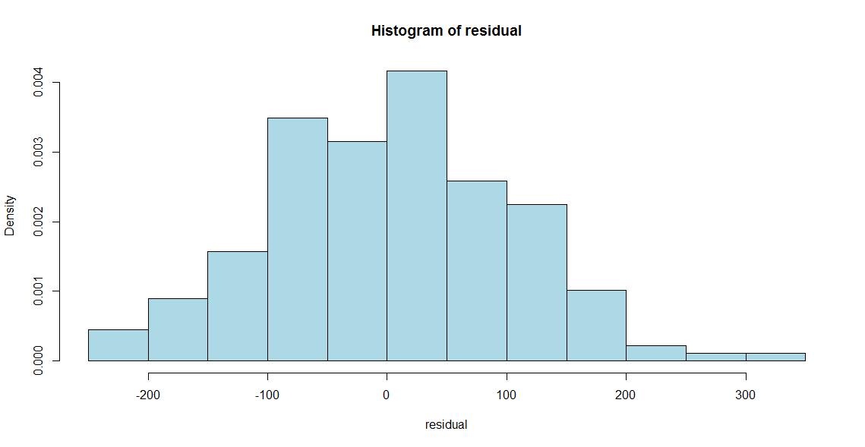
Evaluating Forecasts
A histogram of the forecast errors check whether forecast errors are normally distributed or not

Slide 23
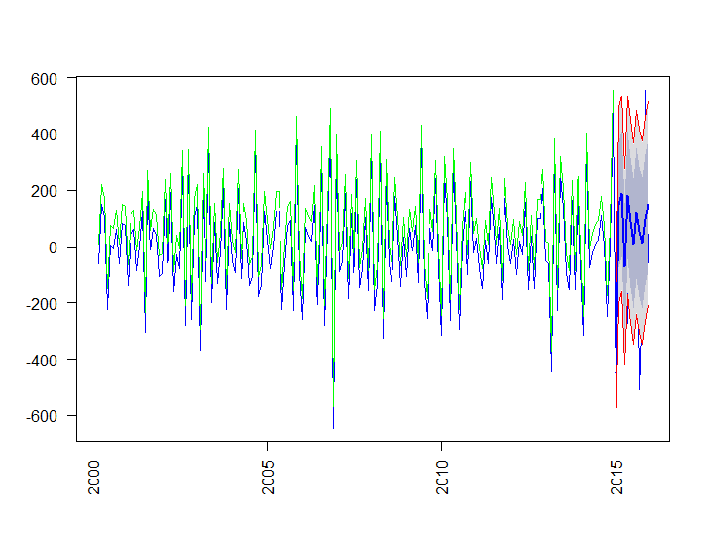
Evaluating Forecasts
The plot of actual values over predicted values shows that both values exactly overlaps.
This analysis resulted in quite adequate predictive model for the export volume of crude oil from Canada to US in 2015 based on the historical data set
Notes:
112

Slide 24
Summary and Future work
a) The export trade volume of crude oil between Canada and USA is predicted using the auto ARIMA function.
b) The predicted values are well within the 95% confidence interval and overlaps the actual values of 2015 which suggest that the autoARIMA method provides an adequate predictive model for crudeoil export volume in 2015.
c) The export volume shows an increasing trend even in 2015 instead of trough which is also predicted from the ARIMA method. This is explained by the increased supply of crude oil from Canada to USA during oil market recession as other exporters decreased their crude oil supply to USA.
d) Other various time series forecasting models (Holt Winters exponential smoothing) can be executed to compare prediction between various methods and increase accuracy of prediction.

Slide 25
References
1. Coghlan A. (2015). A Little Book of R For Time Series. p.1-75.
2. Dickey DA, Fuller WA (1981). “Likelihood Ratio Statistics for Autoregressive Time Series with a Unit Root.” Econometrica, 49, 1057 -1071.
3. Hyndman RJ (2008c). forecast: Forecasting Functions for Time Series. R package version 1.11, URL http://CRAN. R-project.org/package=forecasting.
4. Hyndman RJ and Khandakar Y (2008). Automatic Time Series Forecasting: The forecast Package for R. Journal of Statistical Software, 27, 1-22.
5. Kwiatkowski D, Phillips PC, Schmidt P, Shin Y (1992). “Testing the Null Hypothesis of Stationarity Against the Alternative of a Unit Root.” Journal of Econometrics, 54, 159-178.
6. Melard G, Pasteels JM (2000). “Automatic ARIMA Modeling Including Intervention, Using Time Series Expert Software.” International Journal of Forecasting, 16, 497 -508.
7. Zucchini W., and Nenadic O. Time Series Analysis with R – Part 1, 1-23.

Slide 26
Thank you

